Slide 1

Spring Budget Planning
Academic Senate
Sonoma State University
February 1, 2018

Slide 2

2018-2019
Preliminary Budget Planning

Slide 3
2018-2019 Preliminary Budget Planning
 | Support Budget Request |  | Governor's Budget |  | Sonoma State
General Fund Revenue - Governor's Funding Plan | $ 102,000,000 |  | $ 92,100,000 |  | $ 2,118,300
Net Tuition and Other Fee Revenue (Enrollment Growth) | $ 19,900,000 |  | - |  | -
Board of Trustees Additional Request | $ 161,000,000 |  | - |  | -
Total Revenue | $ 282,900,000 |  | $ 92,100,000 |  | $ 2,118,300
Other Inflationary Cost Increases | $ 17,400,000 |  | - |  | -
Graduation Initiative 2025 | $ 75,000,000 |  | - |  | -
One Percent Increase in Enrollment Growth | $ 39,900,000 |  | - |  | -
Employee Compensation | $ 122,100,000 |  | $ 122,100,000 |  | $ 2,808,300
Academic Facilities and Infrastructure | $ 15,000,000 |  | - |  | -
Mandatory Costs | $ 30,900,000 |  | $ 30,900,000 |  | $ 710,700
Total Expenditures | $ 282,900,000 |  | $ 153,000,000 |  | $ 3,519,000
Cost Avoidance, Efficiencies & Program Reallocations | $ 17,400,000
Funding Shortfall | - |  | $ (60,900,000) |  | $ (1,400,700)
2017-2018 University Structural Deficit |  |  |  |  | $ (359,291)
Total Potential Shortfall to Address in 2018-2019 |  |  |  |  | $ (1,759,991)

Slide 4
2018-2019 Preliminary Budget Planning
 | Support Budget Request |  | Governor's Budget |  | Sonoma State
General Fund Revenue - Governor's Funding Plan | $ 102,000,000 |  | $ 92,100,000 |  | $ 2,118,300
Net Tuition and Other Fee Revenue (Enrollment Growth) | $ 19,900,000 |  | - |  | -
Board of Trustees Additional Request | $ 161,000,000 |  | - |  | -
Total Revenue | $ 282,900,000 |  | $ 92,100,000 |  | $ 2,118,300
Other Inflationary Cost Increases | $ 17,400,000 |  | - |  | -
Graduation Initiative 2025 | $ 75,000,000 |  | - |  | -
One Percent Increase in Enrollment Growth | $ 39,900,000 |  | - |  | -
Employee Compensation | $ 122,100,000 |  | $ 122,100,000 |  | $ 2,808,300
Academic Facilities and Infrastructure | $ 15,000,000 |  | - |  | -
Mandatory Costs | $ 30,900,000 |  | $ 30,900,000 |  | $ 710,700
Total Expenditures | $ 282,900,000 |  | $ 153,000,000 |  | $ 3,519,000
Cost Avoidance, Efficiencies & Program Reallocations | $ 17,400,000
Funding Shortfall | - |  | $ (60,900,000) |  | $ (1,400,700)
2017-2018 University Structural Deficit |  |  |  |  | $ (359,291)
Total Potential Shortfall to Address in 2018-2019 |  |  |  |  | $ (1,759,991)

Slide 5
2018-2019 Preliminary Budget Planning
 | Support Budget Request |  | Governor's Budget |  | Sonoma State
General Fund Revenue - Governor's Funding Plan | $ 102,000,000 |  | $ 92,100,000 |  | $ 2,118,300
Net Tuition and Other Fee Revenue (Enrollment Growth) | $ 19,900,000 |  | - |  | -
Board of Trustees Additional Request | $ 161,000,000 |  | - |  | -
Total Revenue | $ 282,900,000 |  | $ 92,100,000 |  | $ 2,118,300
Other Inflationary Cost Increases | $ 17,400,000 |  | - |  | -
Graduation Initiative 2025 | $ 75,000,000 |  | - |  | -
One Percent Increase in Enrollment Growth | $ 39,900,000 |  | - |  | -
Employee Compensation | $ 122,100,000 |  | $ 122,100,000 |  | $ 2,808,300
Academic Facilities and Infrastructure | $ 15,000,000 |  | - |  | -
Mandatory Costs | $ 30,900,000 |  | $ 30,900,000 |  | $ 710,700
Total Expenditures | $ 282,900,000 |  | $ 153,000,000 |  | $ 3,519,000
Cost Avoidance, Efficiencies & Program Reallocations | $ 17,400,000
Funding Shortfall | - |  | $ (60,900,000) |  | $ (1,400,700)
2017-2018 University Structural Deficit |  |  |  |  | $ (359,291)
Total Potential Shortfall to Address in 2018-2019 |  |  |  |  | $ (1,759,991)

Slide 6
Value of Higher Education

Slide 7
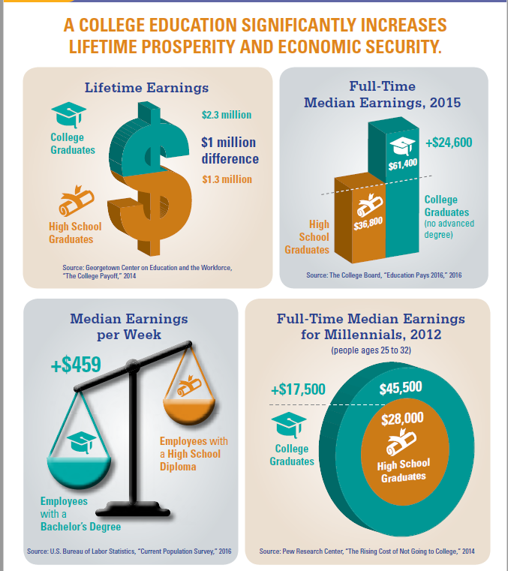
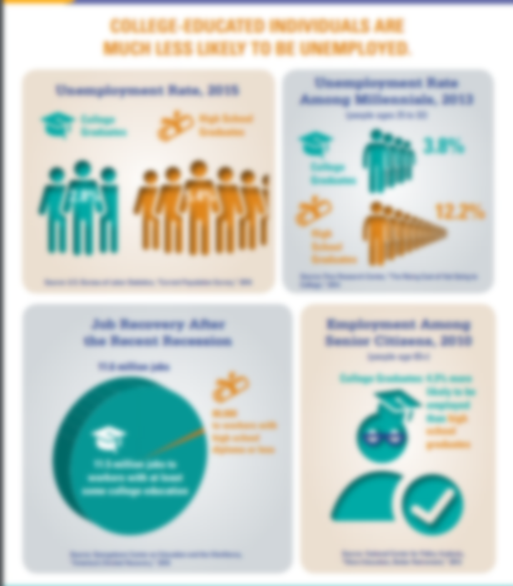

Infographics from NACUBO

Slide 8
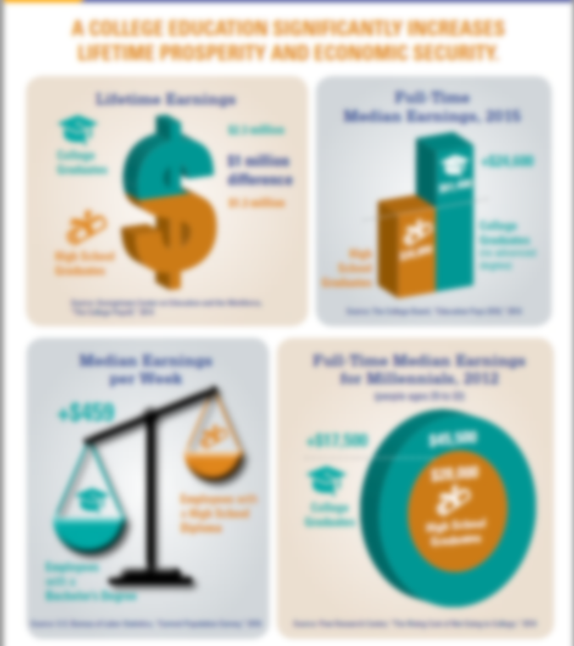
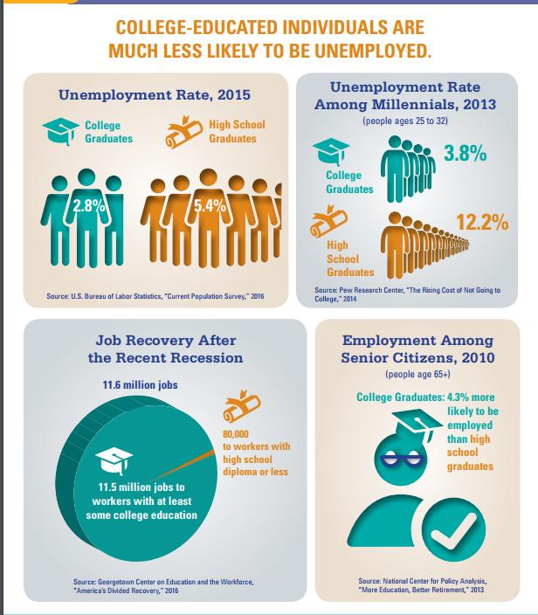
Infographics from NACUBO

Slide 9
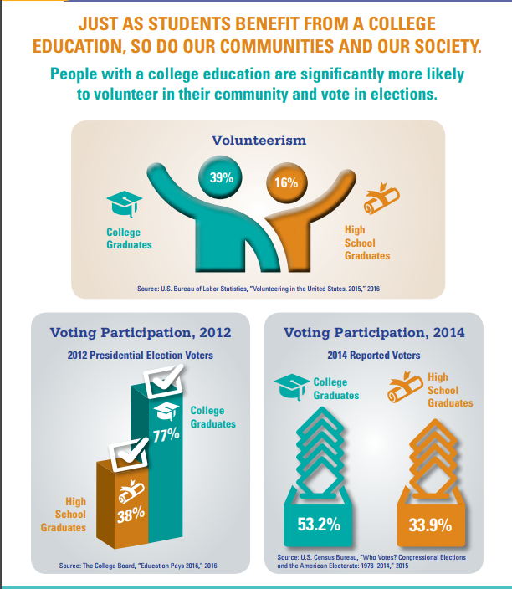
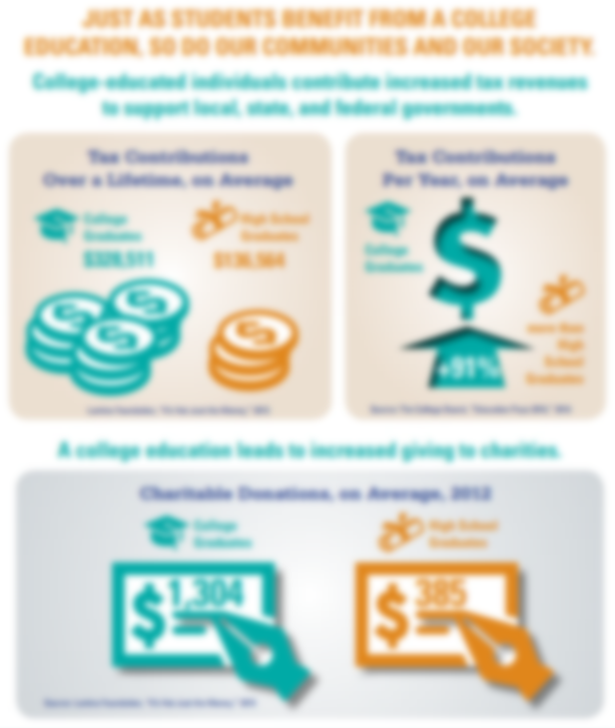
Infographics from NACUBO

Slide 10

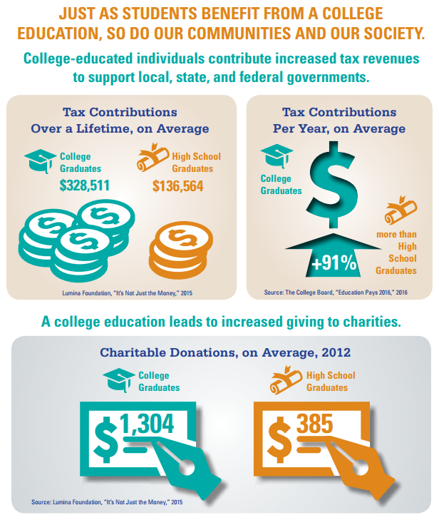
Infographics from NACUBO

Slide 11
Strategic Budgeting

Slide 12

Linking Planning and Budgeting
In the absence of a plan-
  the budget is the plan
If a plan exists and it is not closely linked to the budget-
    the budget is still the plan
Therefore, if a plan is to be implemented,
    there must be a strong linkage between the plan and the budget

Slide 13
Linking Planning and Budgeting
Linking Planning and Budgeting is so difficult because:
Planning is typically conducted at the strategic level
Budgeting is typically focused at the operational level
THEREFORE
We need to develop an approach to strategic budgeting

Slide 14
Why Strategic Budgeting?
To align our budget with our strategic priorities
To improve student learning and success
To strategically invest in our institutional assets
To ensure we are using resources efficiently and effectively
To implement evidence-based budgeting linked to assessment, as required by WASC

Slide 15
Strategic Budgeting
A strategic budget is not just a budget;
it is the strategic plan in action.

Slide 16
Strategic Budgeting Presentation
Please Join the President’s Budget Advisory Committee for
Spring Budget Presentation
March 13, 2018
3:00-5:00 p.m.
Student Center, Ballroom A

Slide 17
Spring Budget Planning
Academic Senate
Sonoma State University
February 1, 2018

